Slide 1
MALIGNANT COMMENT CLASSIFIER
SUBMITTED BY – ARUNPRASAD.K

Slide 2

Internet comments are bastions of hatred and vitriol. While online anonymity has provided a new outlet for aggression and hate speech, machine learning can be used to fight it. The problem we sought to solve was the tagging of internet comments that are aggressive towards other users. This means that insults to third parties such as celebrities will be tagged as unoffensive, but “u are an idiot” is clearly offensive.

Slide 3
LET’s BEGIN NOW
Welcome to our presentation
The proliferation of social media enables people to express their opinions widely online. However, at the same time, this has resulted in the emergence of conflict and hate, making online environments uninviting for users. Although researchers have found that hate is a problem across multiple platforms, there is a lack of models for online hate detection.
Online hate, described as abusive language, aggression, cyberbullying, hatefulness and many others has been identified as a major threat on online social media platforms. Social media platforms are the most prominent grounds for such toxic behaviour.
There has been a remarkable increase in the cases of cyberbullying and trolls on various social media platforms. Many celebrities and influences are facing backlashes from people and have to come across hateful and offensive comments. This can take a toll on anyone and affect them mentally leading to depression, mental illness, self-hatred and suicidal thoughts.

Slide 4
PROBLEM STATEMENT AND OBJECTIVES
problem statement
The problem we sought to solve was the tagging of internet comments that are aggressive towards other users
objective
Our goal is to build a prototype of online hate and abuse comment classifier which can be used to classify hate and offensive comments so that it can be controlled and restricted from spreading hatred and cyberbullying.

Slide 5
APPROACH
The internet comments that are toxic/ clean are used for training and testing the models.
The Dataset contains multiple labels to mark the toxicity of the comments. We are dealing with a multi-label classification problem.
The comments are used as the input. These comments are cleaned and lemmatized before being fed into the models
The text comments are then vectorized using TFIDF vectorizer with 1-3 grams.
OneVsRest technique is used to solve this problem and the base algorithm used is Logistic Regression.
The probabilities of each label can be predicted using this algorithm.

Slide 6
EDA
This is a Multi-label classification problem. The target variables are binary variables.
Variable Data-types:
The dataset contains comments which is in text format and the target variables in binary format.
Null Values: There are NO Null values in the dataset.
Shape: In Train dataset, there are 159571 rows and 8(6 target variables, 1 comment field and an id field) columns.In Test dataset, there are 153164 rows and 2(1 comment field and an id field) columns.
The dataset has text features.

Slide 7
DATA CLEANING
Email addresses are converted to the text ‘emailaddress’.
Web site links are converted to the text ‘webaddress’
Phone numbers are converted to the text ‘phonenumber’
Currencies are converted to the text ‘currencyamount’
Numbers are converted to the text ‘numbr’.
The non-alphabetic characters are removed from the review texts.
Extra white spaces are removed.
Stop words are removed.
Any unwanted repeating patterns of characters are removed.

Slide 8
TEXT DATA ENCODING
TFIDF was used to encode the text data ‘comment_text’:
Monograms, bigrams and trigrams are used with TFIDF vectorizer.
1,00,000 is used as the max_feature value to avoid memory error and slowness.
Word2Vec Model, Adaptive algorithms and ensemble techniques caused out of memory errors.

Slide 9
VISUALIZATION

Slide 10
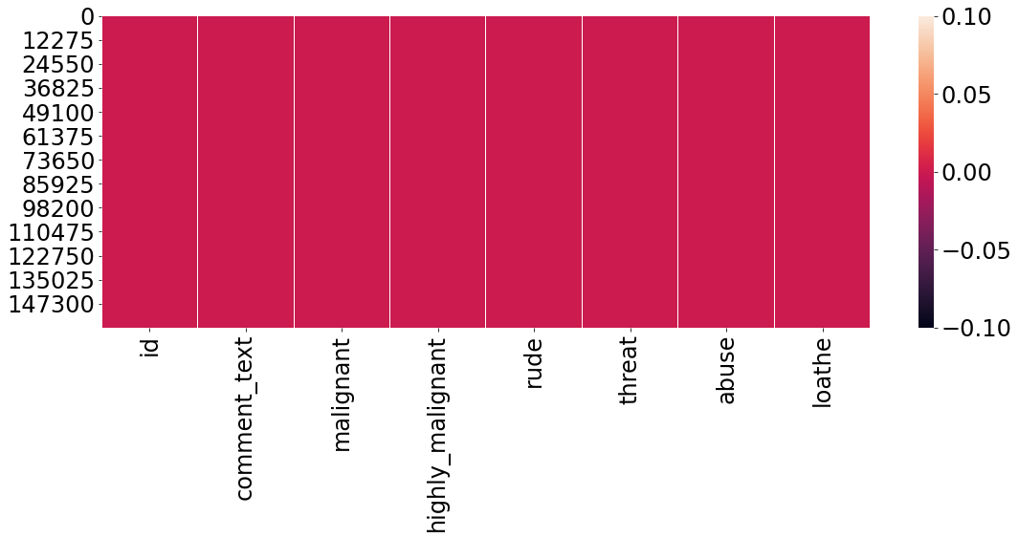
NAN VALUES
HEAT MAP
No Missing values

Slide 11
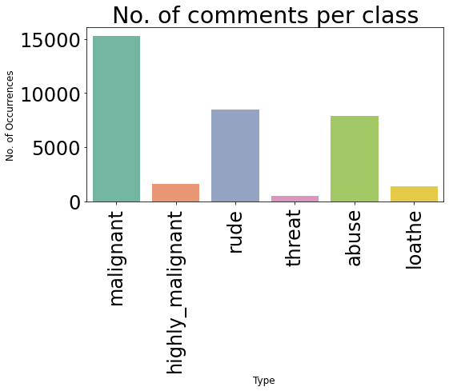
NO OF COMMENTS PER CLASS

Slide 12
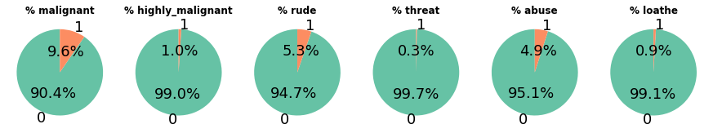
PIE CHART ON PERCENTAGE OF EACH LABEL COMBINATION

Slide 13
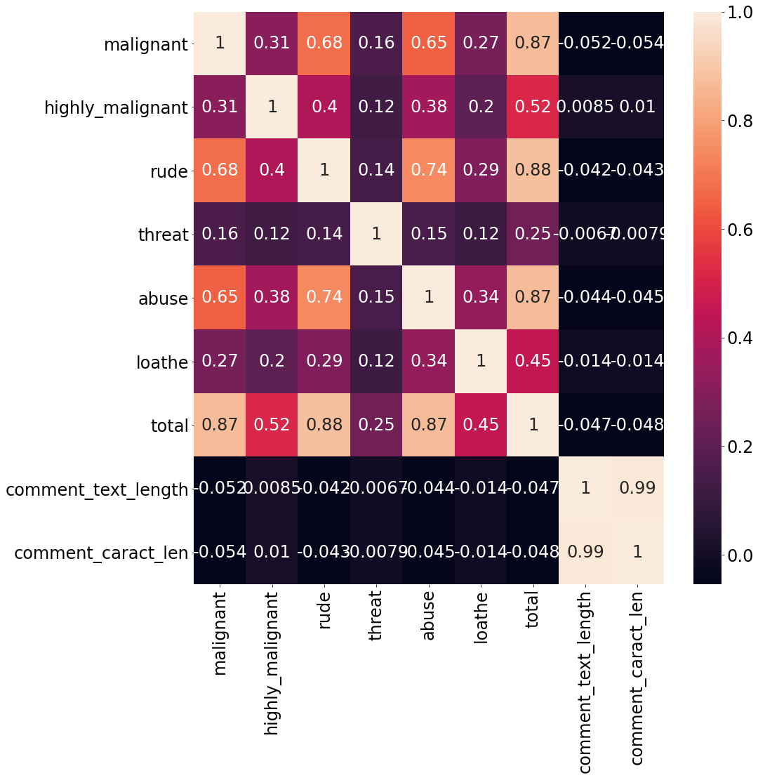
CORRELATION MATRIX

Slide 14
STEP TAKEN TO COMPLETE THE PROJECT
Performed data cleaning based on NLP approaches.
Trained and validated different Machine Learning multi-label classification techniques
The Machine Learning Algorithms like logisticRegression, KNeighborsClassifier, MultinomialNB, BernoulliNB, LinearSVC, RandomForest Classifier are tried .
Chose the final model based on Micro F1 score since the dataset is heavily imbalanced.

Slide 15
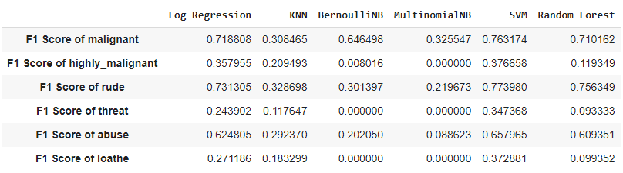
F1 SCORE

Slide 16
PREDICTION
LABEL | TRAINING ACCURACY | TESTING ACCURACY
MALIGNANT | 98.53 | 95.95
HIGHLY MALIGNANT | 99.60 | 99.08
RUDE | 99.29 | 97.85
THREAT | 99.92 | 97.74
ABUSE | 98.97 | 97.04
LOATHE | 99.76 | 99.22

Slide 17
FINAL MODEL
The final model used is Linear SVC Model.
The vectorization is done using 1-1 grams TFIDF Vectorizer
The tuned hyper parameters used are:
LinearSVC(C=1.0, class_weight=None, dual=True, fit_intercept=True,
intercept_scaling=1, loss='squared_hinge', max_iter=1000,
multi_class='ovr', penalty='l2', random_state=None, tol=0.0001,
verbose=0)

Slide 18
CONCLUSION
This research work focuses on developing a model that would automatically classify a comment as either Malignant or non-Malignant using logistic regression to develop a multi-headed model to detect different types of Malignantity like threats, obscenity, abuses, and loathe.
By collecting and preprocessing Malignantity classified comments for training and testing using inverse document frequency(TF-IDF ) algorithm, developing a multi-headed model will detect different types of Malignantity using logistic regression to train the dataset, and evaluate the model using F1 score.

Slide 19
Thank you!
Any Questions?

